Slide 1
Theater Etiquette
How to Be a
Good Audience Member
© PowerPoint by Maria Bellamy, Breathitt Co. High School, Jackson, KY; rules provided by Jenny Wiley Theatre and graphics from Microsoft Office online

Slide 2
Arrive early
You must be in your seat for the play to start on time
The lights in the theater will dim as a signal that the play is about to start
© PowerPoint by Maria Bellamy, Breathitt Co. High School, Jackson, KY; rules provided by Jenny Wiley Theatre and graphics from Microsoft Office online

Slide 3
Be quiet during the play
.
.
.
.
.
.
.
.
.
.
.
Do not talk
Do not unwrap candy
Do not make noise
You have a responsibility in live performance to the performers and to the rest of the audience
© PowerPoint by Maria Bellamy, Breathitt Co. High School, Jackson, KY; rules provided by Jenny Wiley Theatre and graphics from Microsoft Office online

Slide 4
Silence your electronics
Make sure these items are turned off or set on ‘silent’ during the show:
beepers
cell phones
watches
© PowerPoint by Maria Bellamy, Breathitt Co. High School, Jackson, KY; rules provided by Jenny Wiley Theatre and graphics from Microsoft Office online

Slide 5
No recording!
Recording is NOT ALLOWED. This includes all photography, video or audio recordings
Such recording is illegal as well as annoying!
.
.
.
.
.
.
.
.
.
.
© PowerPoint by Maria Bellamy, Breathitt Co. High School, Jackson, KY; rules provided by Jenny Wiley Theatre and graphics from Microsoft Office online

Slide 6
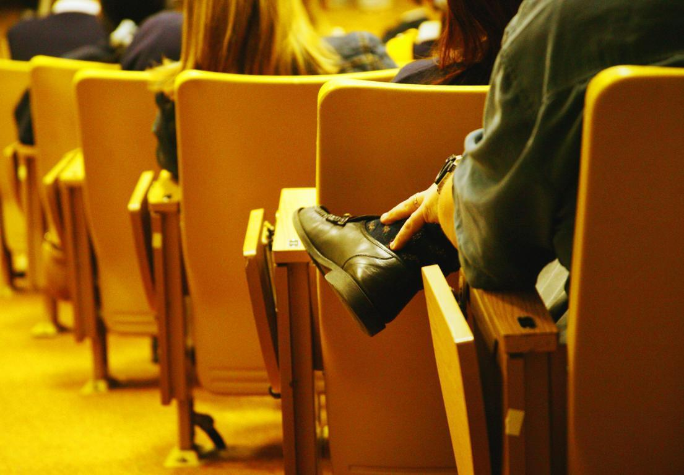
Stay in your seat
Audience members must stay seated during the performance.
Audience members may stand only for an emergency.
© PowerPoint by Maria Bellamy, Breathitt Co. High School, Jackson, KY; rules provided by Jenny Wiley Theatre and graphics from Microsoft Office online

Slide 7
Intermission
If the play is very long, there will be an intermission, or short break, in the middle.
You may stand and talk during intermission.
Bathrooms can be very crowded,
so take the shortest break
possible.
You must be back in your seat before intermission ends and the play resumes.
© PowerPoint by Maria Bellamy, Breathitt Co. High School, Jackson, KY; rules provided by Jenny Wiley Theatre and graphics from Microsoft Office online

Slide 8
Be courteous
Wait patiently at the ticket booth, the exit,
the restroom,
etc.
Intermission
time is
limited—be
quick
© PowerPoint by Maria Bellamy, Breathitt Co. High School, Jackson, KY; rules provided by Jenny Wiley Theatre and graphics from Microsoft Office online

Slide 9
Observe ALL rules
Theatre rules are for the safety and well-being of the audience and the performers
Respect ALL rules and policies!
© PowerPoint by Maria Bellamy, Breathitt Co. High School, Jackson, KY; rules provided by Jenny Wiley Theatre and graphics from Microsoft Office online

Slide 10
After the performance
If you think the play was good, applaud enthusiastically.
If you think a performance was truly outstanding, stand and applaud loudly (“standing ovation”).
If you did not like it, sit quietly in your seat until you can leave.
© PowerPoint by Maria Bellamy, Breathitt Co. High School, Jackson, KY; rules provided by Jenny Wiley Theatre and graphics from Microsoft Office online

